Slide 1

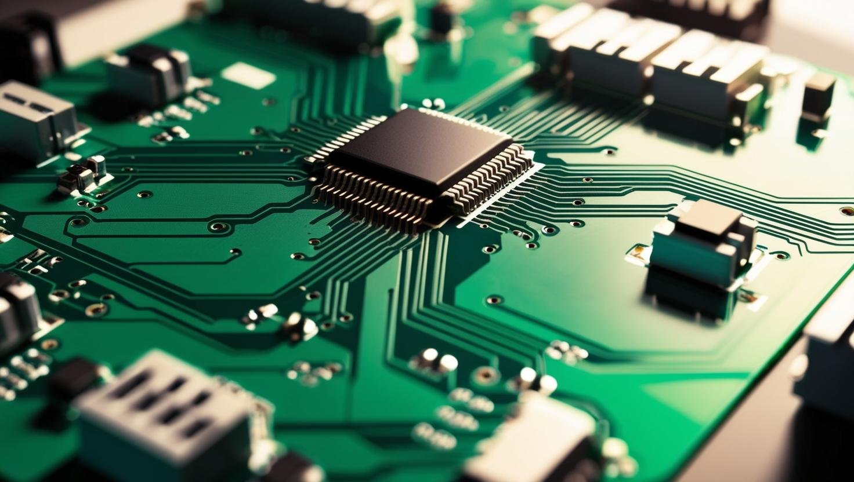
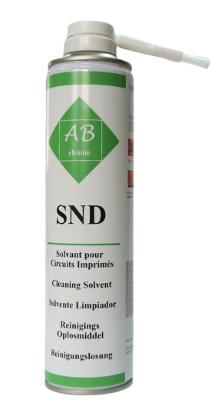
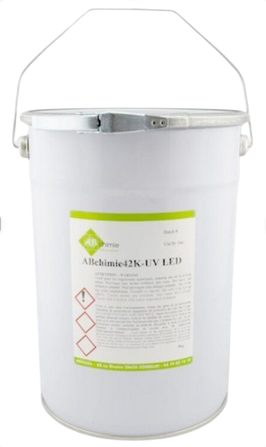
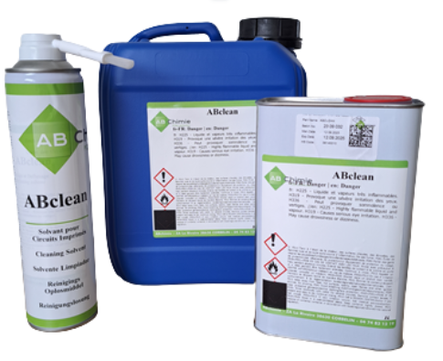
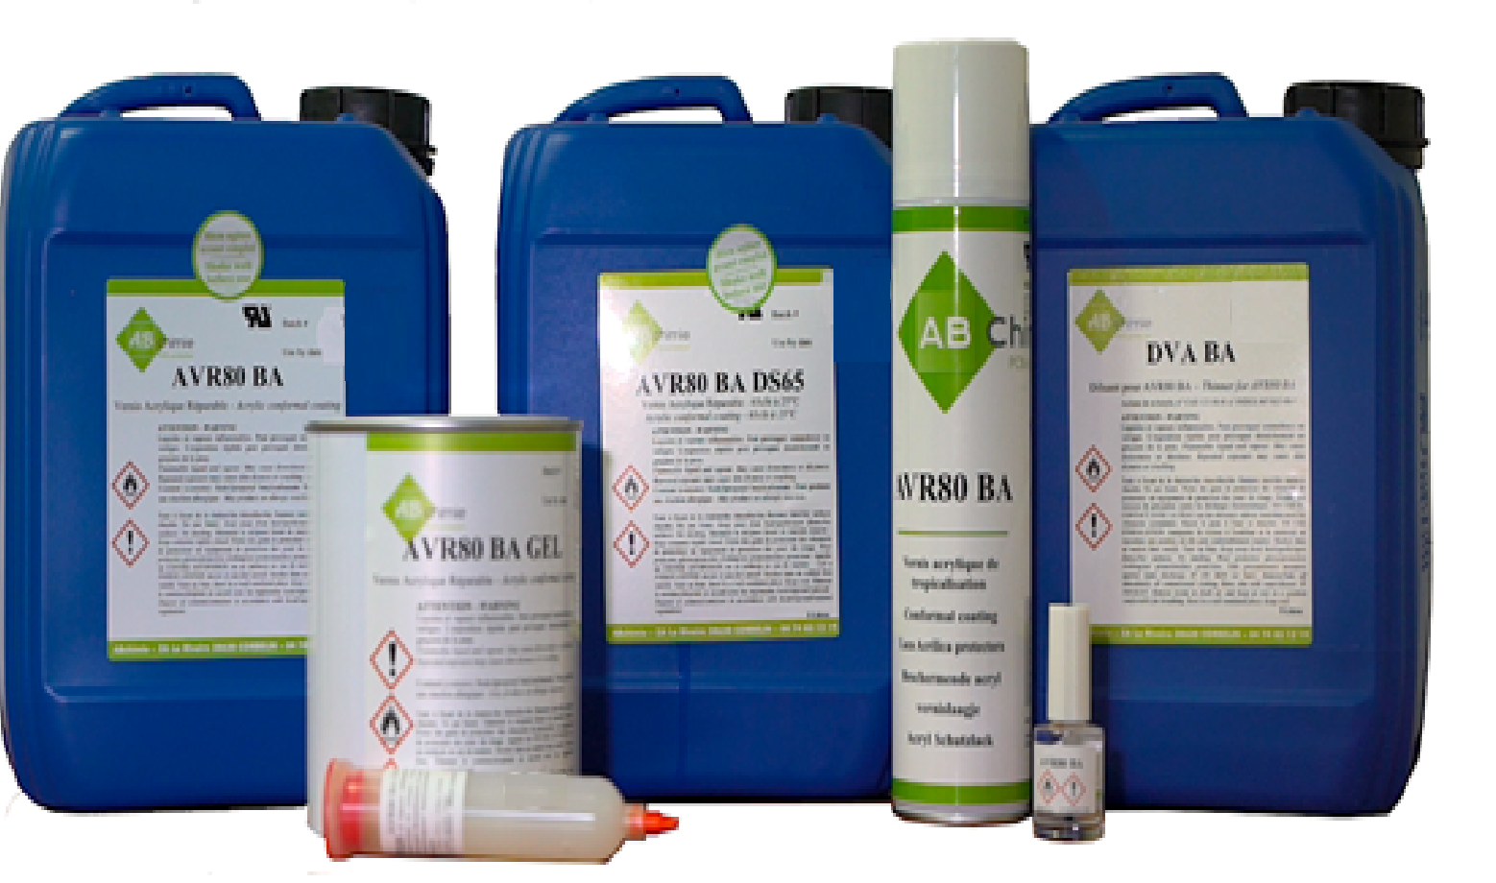
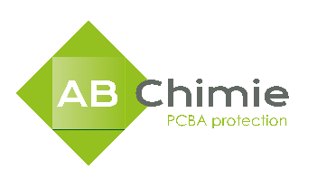
AB CHIMIE COMPANY OVERVIEW
ABchimie is a French company with extensive experience providing protection and cleaning solutions for electronic circuits.
Their wide product range and focus on innovation, quality, and sustainability make them a trusted partner for global industries.

Slide 2
AB CHIMIE PRODUCT RANGE OVERVIEW
Conformal Coatings
ABchimie's conformal coatings are specially developed to ensure high protection of printed circuit board assemblies (PCBAs) from environmental factors such as humidity, temperature variations, solvents, and dust. These coatings enhance the reliability and lifespan of electronic devices.
Resins humidity / UV LED Curing
These products are formulated to ensure optimal protection for electronic components and are suitable for a wide range of applications. They cure rapidly under UV light, facilitating efficient processing. UV-curable dual function resins offering excellent adhesion and protective properties, ideal for encapsulating sensitive components.
UV Glues
These resins serve as excellent insulators against aggressive environments and contribute to the mechanical protection of PCBAs. They are suitable for potting and encapsulation applications.
Cleaning Products
ABchimie offers a range of cleaning solutions to eliminate flux residues, greases, and other contaminants, there by increasing the reliability of PCBAs.

Slide 3
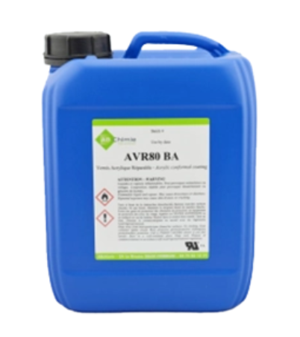
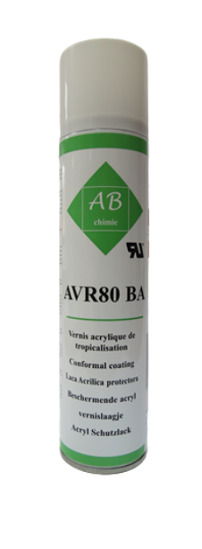
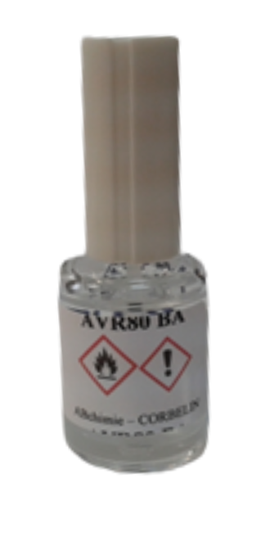

ACRYLIC CONFORMAL COATING - AVR80 BA
A flexible, transparent acrylic conformal coating designed for the protection of electronic circuitry. It offers excellent adhesion under all climatic conditions and fluoresces under UV light to aid inspection.
  Wide temperature range -65°C to +150°C
  Transparent coating with UV TRACER
  Can be partially or totally removed with ABchimie SND
  Drying Time:
    <20 min. touch dry
    24 hours optimum properties
  Packaging : Can, Aerosol, Pen, Bottle (10 ml)
  NON TOXIC
AVR80 BA GEL
A gel variant of the AVR80 BA, providing a thicker, more localized protective layer. It maintains the same protective properties and is ideal for applications requiring precise application.
APPLICATION INDUSTRIES:
    automotive, aerospace, military, homeappliances, medical, industrial

Slide 4
HOW TO APPLY AVR80 BA ?
  Automated selective machine
    Film coater
    Jetting
    Spray
  Manual
    Spray gun
    Aerosol
    Dipping
    Brush
    Pen
AVR80 BA : HOW TO REMOVE IT?
Locally :
  Pen
  Aerosol (with brush)
Totally :
  Aerosol (with brush)
  Can (by dipping)
4

Slide 5



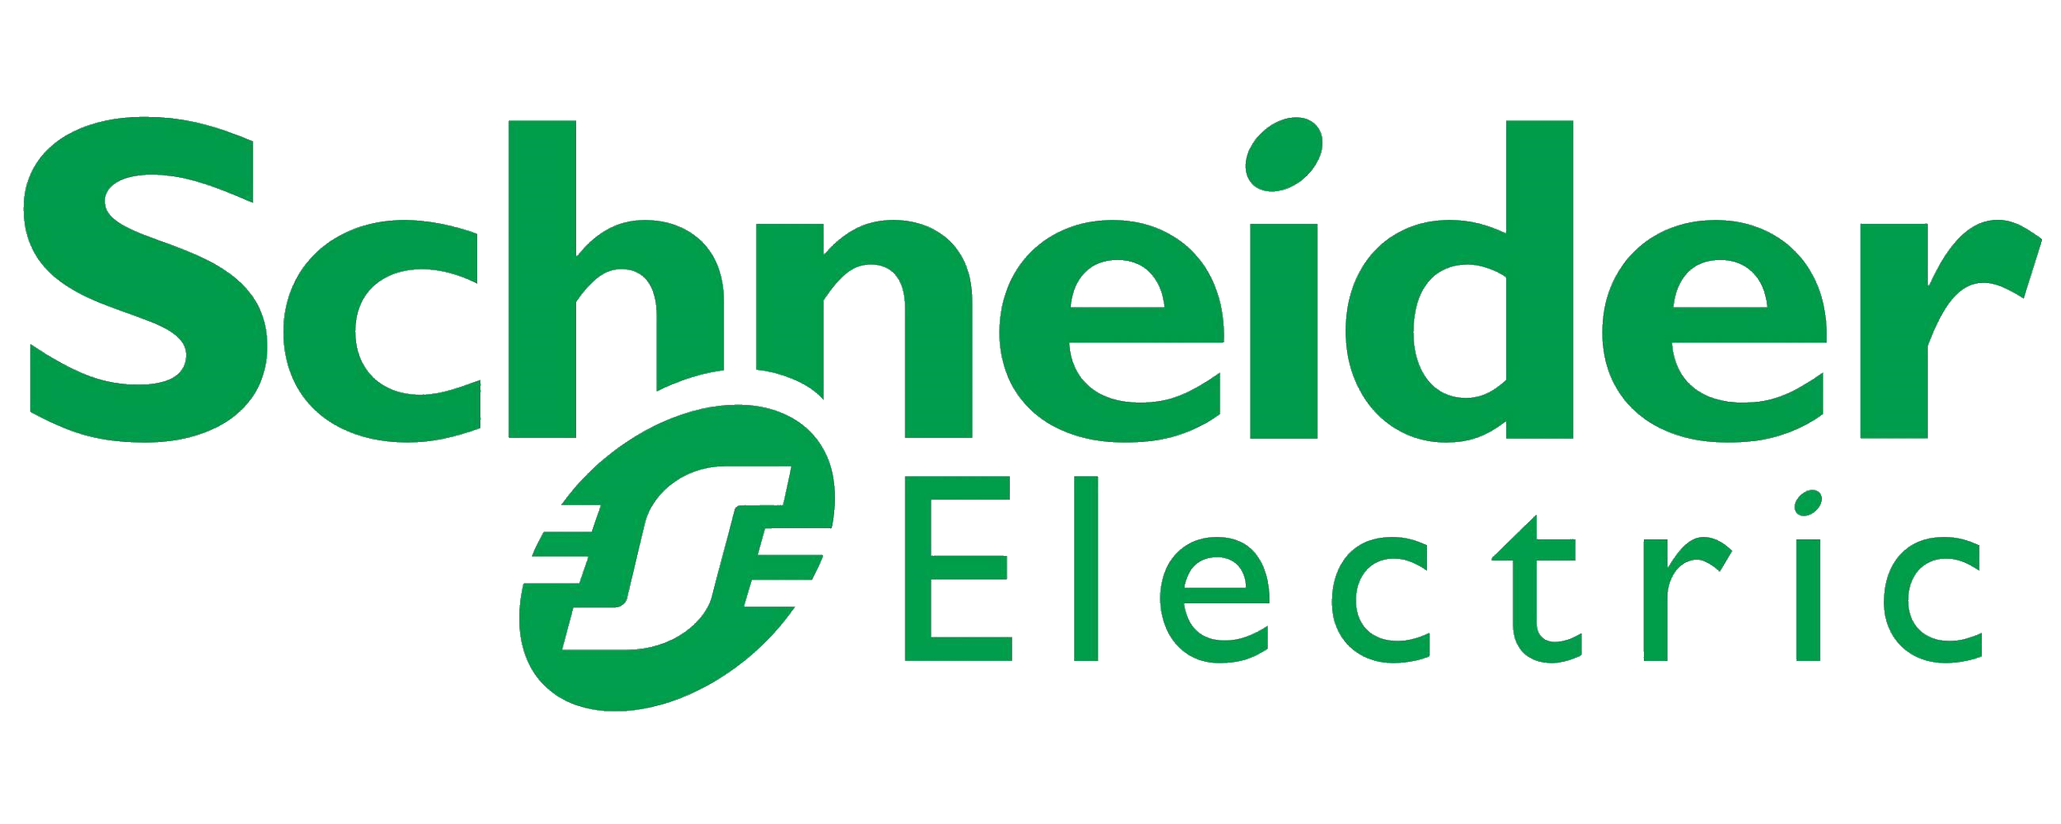
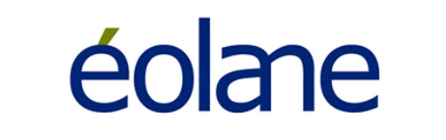
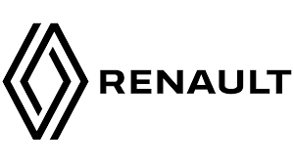
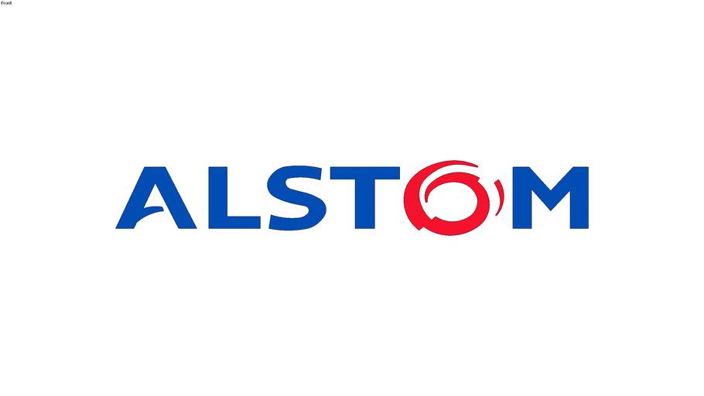
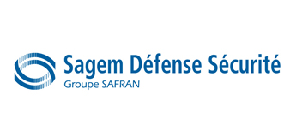
AVR80 BA : CUSTOMERS REFERENCES
Aeronautic and Military: Airbus, Safran, Zodiac, Dassault Aviation, Sagem Defense & Security…
Industrial: Schneider Electronics, Delta Dore, Eolane, Petzl, Osram…
Railway: Alstom, RATP, SNCF, Ansaldo, Faiveley, Bombardier…
Automotive : SMR Auto, Volvo Trucks, Renault…
5

Slide 6
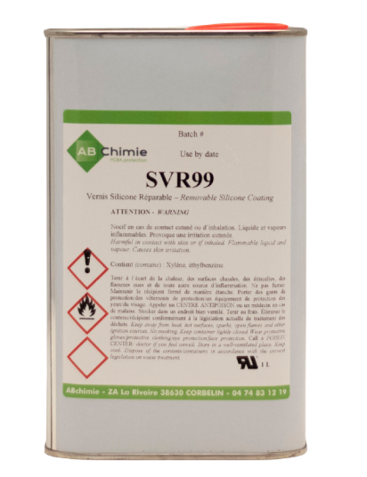
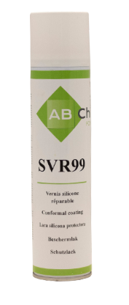
SILICON CONFORMAL COATING - SVR 99
A silicone-based conformal coating known for its high-temperature resistance and flexibility, suitable for applications exposed to extreme environmental conditions.
Excellent moisture and humidity resistance
Silicone-based transparent coating with UV TRACER
Can be soldered through without toxic fumes
Drying time:
  Touch dry: ~4 hours at room temp
  Full cure: 12 hours (faster with heat)
Application: Spray, dip, brush (~25 μm per layer)
Operating temp: -55 °C to +200 °C
Packaging: Aerosol (400 ml), Drum (5 L)
NON TOXIC, mold and UV resistant
APPLICATION INDUSTRIES:
    automotive, telecom, industrial, marine electronic

Slide 7
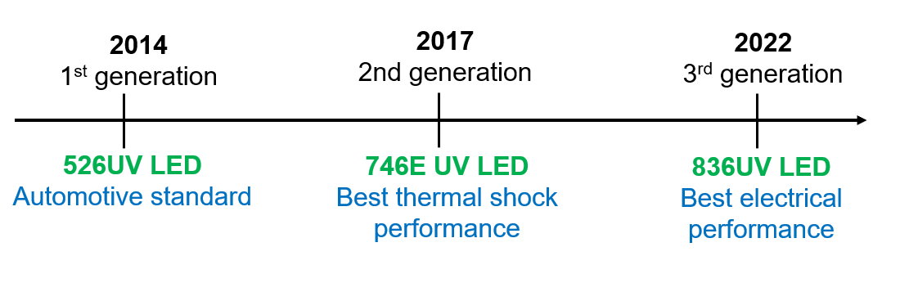
AB CHIMIE UV LED CONFORMAL COATING DEVELOPMENT
These products are formulated to ensure optimal protection for electronic components and are suitable for a wide range of applications. They cure rapidly under UV light, facilitating efficient processing.
→ All 3 coating can be applied with spray coater and film coater from 50-130 microns
→ Hg curable version is also available for 3 materials
7

Slide 8
ABCHIMIE UV LED - COMPARISON
8

Slide 9
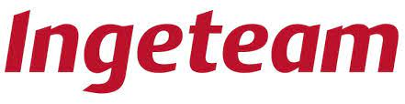
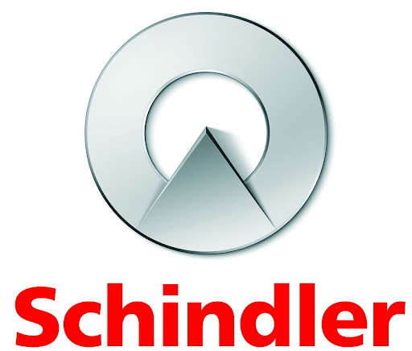
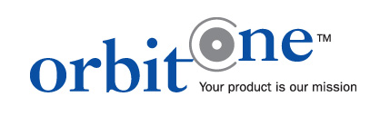
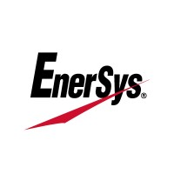
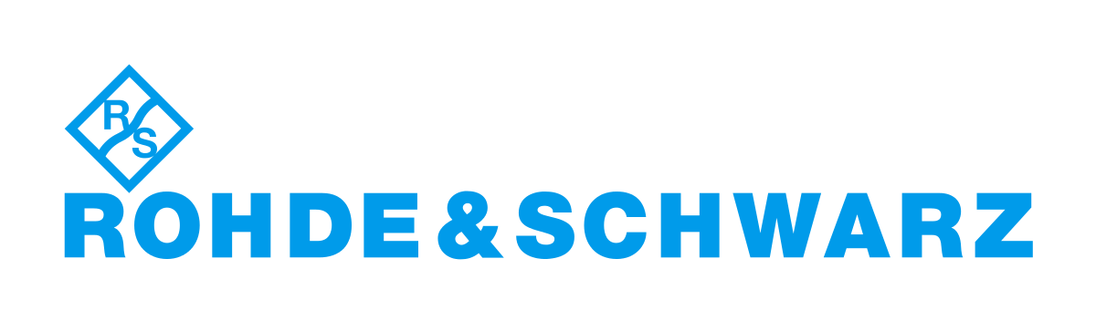

AB CHIMIE 746E UV - CUSTOMERS REFERENCES:
9

Slide 10
RESIN - ST21
Composition:
Two-component epoxy system comprising ST21 A resin and CA51 B hardener.
Viscosity at 25°C:
ST21 A Resin: 6,000 – 10,000 mPa​
CA51 B Hardener: 40 – 150 mPa
Color: Standard color is black.​
Specific Gravity at 25°C:
ST21 A Resin: 1.61 – 1.65 g/cm³
CA51 B Hardener: 0.98 – 1.02 g/cm³​
APPLICATION INDUSTRIES:
Applications: Designed for potting and encapsulating electronic components to protect against moisture, vibration, and thermal or mechanical shocks.
    automotive, military, industrial, household appliance

Slide 11
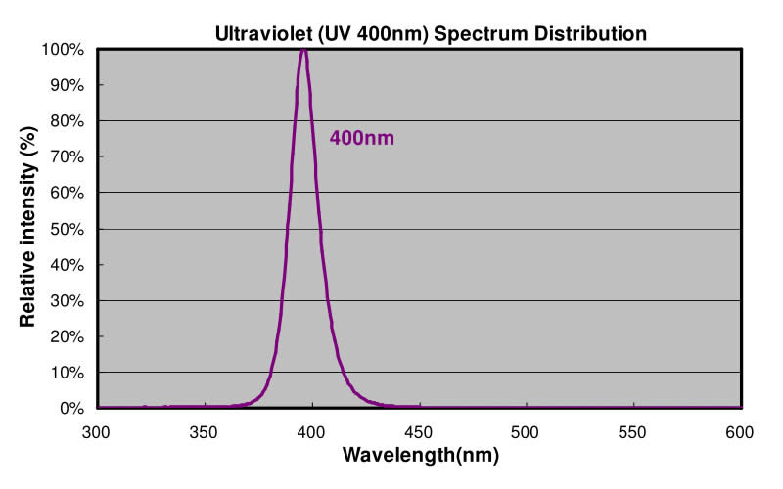
UV LED RESIN / GLUE - 42K
Soft, single-component UV-curable resin
Designed for local protection of components (moisture, electrical insulation)
Can be applied in thick layers (up to several mm)
Cures instantly under UV light (395 nm)
Excellent adhesion to various substrates (plastics, PCB, metal)
Packaging: 30 ml syringe, 1 kg, 5 kg
Operating temperature: -55 °C to +150 °C
VOC-free, NON TOXIC
UV LED
UV LED RESIN / GLUE - 80K
Transparent single-component conformal coating
Dual cure: UV LED + moisture for full coverage
Instant surface cure with UV LED
Operating temperature: -50 °C to +150 °C
High adhesion and durability in harsh environments
Application: Spray, Brush, Selective Coating
Recommended thickness: 30–130 µm
Packaging: 30ml syringe, 1 kg, 5kg, 20kg
NON TOXIC
→ Single focused wavelength
APPLICATION INDUSTRIES:
    industrial, automotive, high-reability electronics, railway, aerospace

Slide 12
UV LED GLUE - 9111 UV
Description:
Soft, clear UV-curable adhesive designed for bonding a variety of materials including glass, metals, and plastics. Cures instantly under UV light. After curing, the adhesive remains transparent and non-yellowing.
Bonds glass, PMMA, aluminum, plastics
Instant cure under UV (365 nm)
Non-yellowing, flexible after cure
Viscosity: ~10,000 cP
Layer thickness: 100–1000 µm
Adhesion: up to 3 MPa (glass/aluminum/PMMA)
Packaging: 30 ml syringe, 1 kg, 5 kg
VOC-free, NON TOXIC
IDEAL FOR:
• Optical bonding
• Decorative or transparent assemblies
• Glass-to-glass or glass-to-metal sealing

Slide 13
CLEANING - ABClean
Universal electronics cleaner
Removes flux residues, oils, and contaminants
Safe for most plastics and components
Use: manual or machine cleaning
Fast drying, leaves no residue
Packaging: various sizes (typically 1L, 5L, etc.)
VOC-compliant, NON TOXIC
HOW TO CLEAN:
Locally :
  Pen
  Aerosol (with brush)
Totally :
  Aerosol (with brush)
  Can (by dipping)
CLEANING - SND
Fast-drying defluxing/degreasing solvent
Removes grease, oil, flux, and acrylic coatings
Safe for plastics, elastomers, coatings
Leaves no residue, non-conductive
Packaging: 400 ml aerosol (SND400B), 1L, 5L, 30L
100% ozone-friendly, no CFCs / halogens

Slide 14
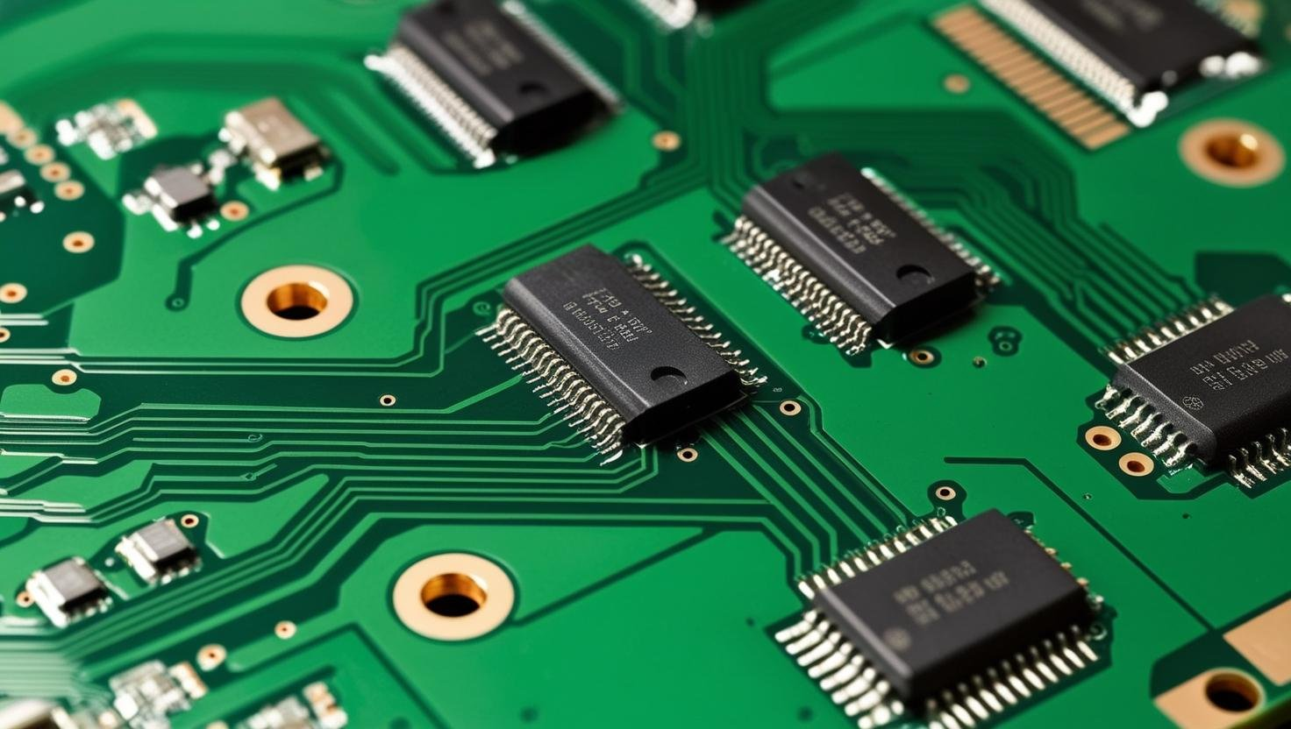
INTERESTED IN AB CHIMIE PRODUCTS OR WANT TO LEARN MORE?
Visit www.atd-shop.com or www.atd-elektronik.cz
for additional information or inquiry.
Luženice č. 10
34401 Domažlice
Česká republika
Tel. +420 379 723 915
info@atd-elektronik.cz
www.abchimie.com for latest information.
Thank you for your attention.

